Slide 1

Realtime Face and Mask on-off Detection
Instructor
Tanmoy Chakraborty
Rahul Maheshwari
MT19027
Group No. 12
Drive link

Slide 2
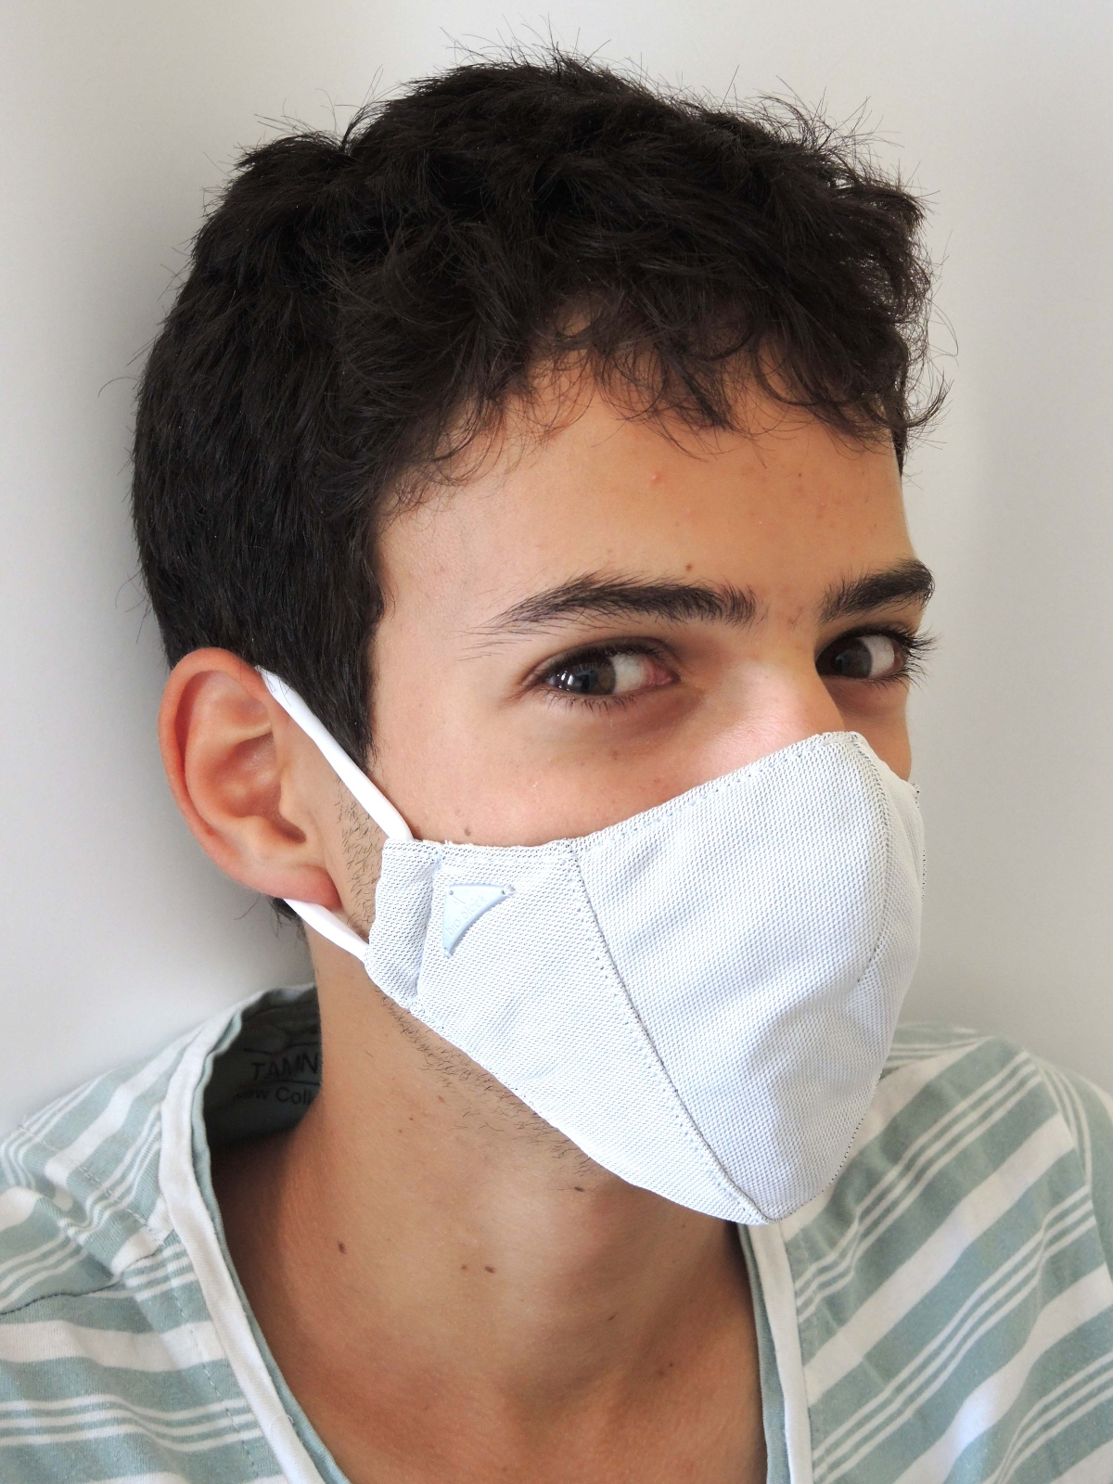
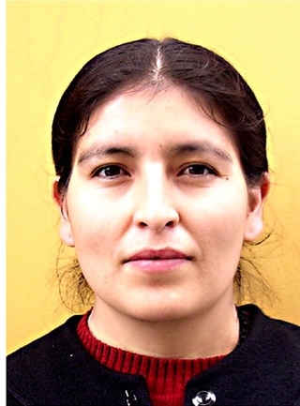
Dataset description
Dataset used for the proposed system is created by Chandrika Deb [5] and is created from real people’s mask on and mask off images. Dataset was created with the help of scraping with Bing search, Kaggle dataset, and RMFD dataset.
The dataset contains a total of 3868 images out of which 1938 images are with mask on and 1930 images are without mask.
Sample image with mask
Sample image without mask

Slide 3
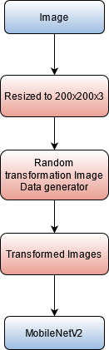
Pre-processing
Images in dataset are not of a fixed size hence they are first resized to size 200x200x3.
Data augmentation is done by applying random transformation to the training data in order to prevent overfitting and provide more robust training of the model.
Transformed images are given as input to the MobileNetV2 model.
Pre-processing pipeline

Slide 4
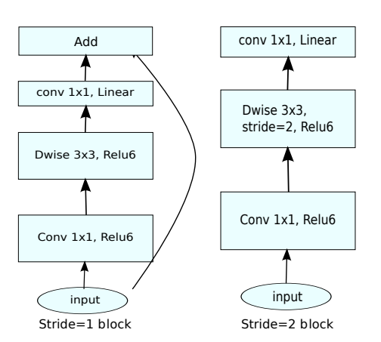
Model Architecture
For face detection, state of the art Caffe ResNet10 with imagenet weights is used as it is highly accurate in detecting multiple faces as it was trained on more than a million images and trained for 140000 iterations.
For mask detection on the extracted faces, MobileNetV2 is used which contains an array of convolutional blocks of small size and considered as a lightweight model.
MobileNetV2 makes it possible to deploy the system on computationally less powerful devices also.
The architecture contains a total of 16 blocks with an average pooling layer, dense layer, dropout layer and a softmax output layer.
The model has a total of 2,422,210 parameters out of which 164,226 parameters were trainable as pre-trained layers of MobileNetV2 architecture is implemented.
MobileNetV2 architecture

Slide 5
Approach
The task at hand to perform the classification after capturing the faces from a frame is carried out using Deep learning technique. The task is carried out in two phases.
First phase is training of the MobileNetV2 model with the dataset mentioned above and serialize the best parameters for the mode. The model is trained using CUDA cores of GPU for efficient training.
Second phase is to detect faces using Caffe ResNet10 from image or real time video stream and extract ROI (Region of Interest) which is sent to the trained MobileNetV2 model in order to classify each detected face as with mask or without mask.
Any face detected without mask is labeled with a red color frame with text as “No Mask” and a green color frame for faces with masks with text “Mask” along with the probability of detection.
All the functionalities are integrated in a web based cross-platform GUI

Slide 6
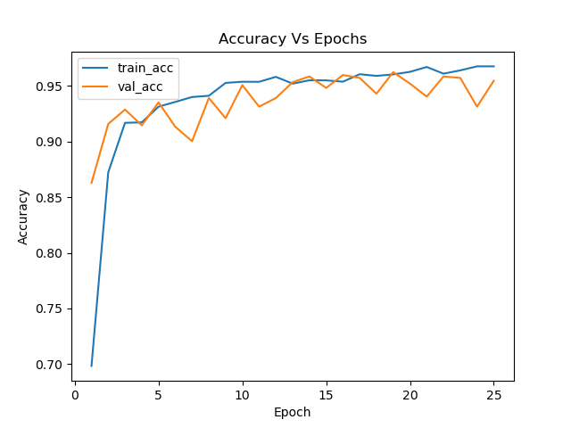
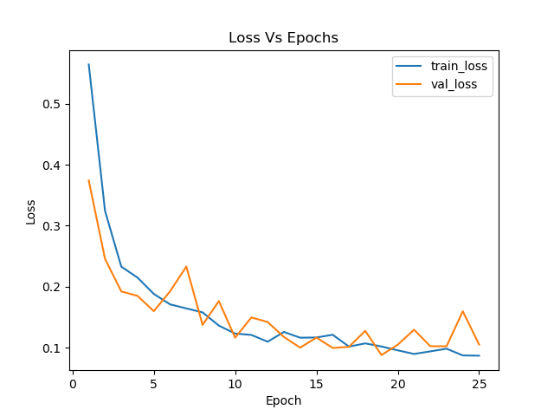
Results
Accuracy and loss were observed for 25 epochs and plotted for better visualization and analysis of the performance of the DNN MobileNetV2 model.
As the model was trained on real world images with samples of multiple scenarios, it performed very well and gave 95-96 % accuracy.
The model didn’t overfit which is clearly seen in the plots.
Balanced f1-score of .95 states that the model has very good performance and can classify with mask images and without mask images with similar accuracy.
Accuracy Plot
Loss Plot

Slide 7
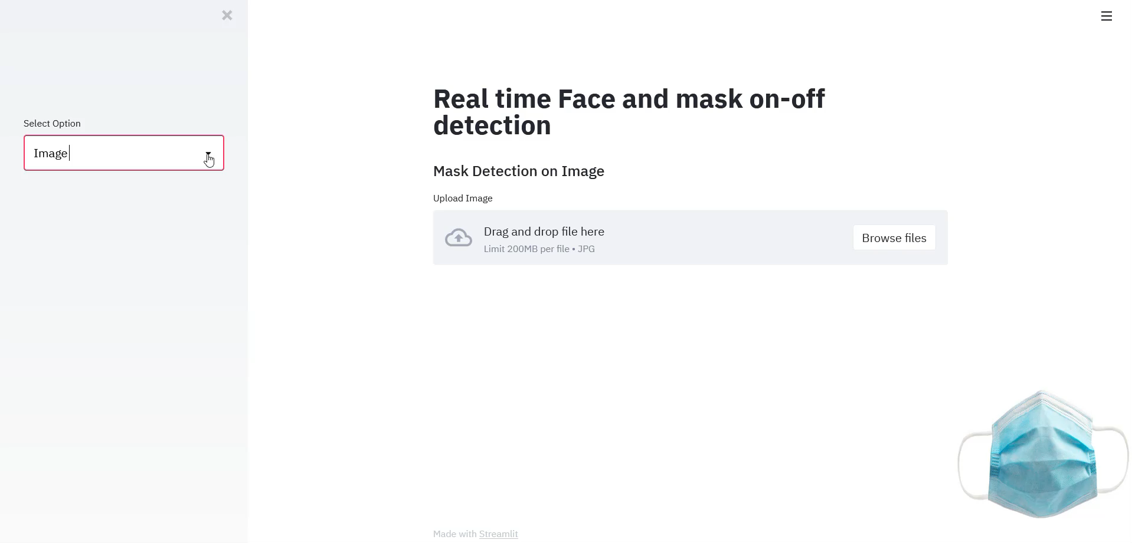
Results (contd…)
Real-time video stream screenshots
Model also performed very well on live video stream and images.
It also works well with multiple faces and faces with spectacles.
The model is very lightweight, hence can be integrated with video surveillance systems as a complete mask surveillance system under COVID-19 protocols.

Slide 8
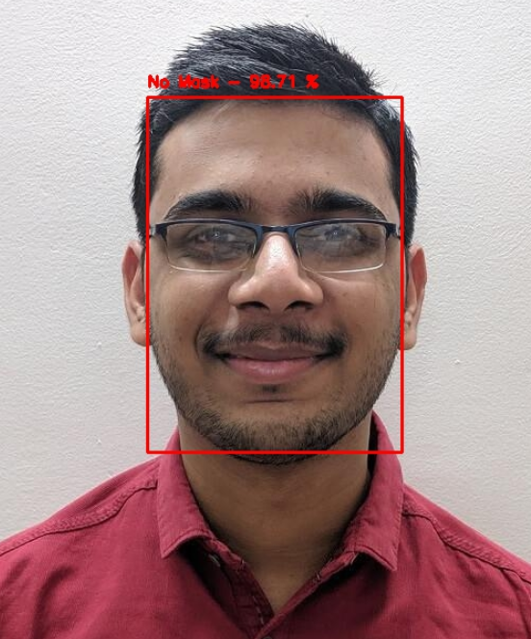
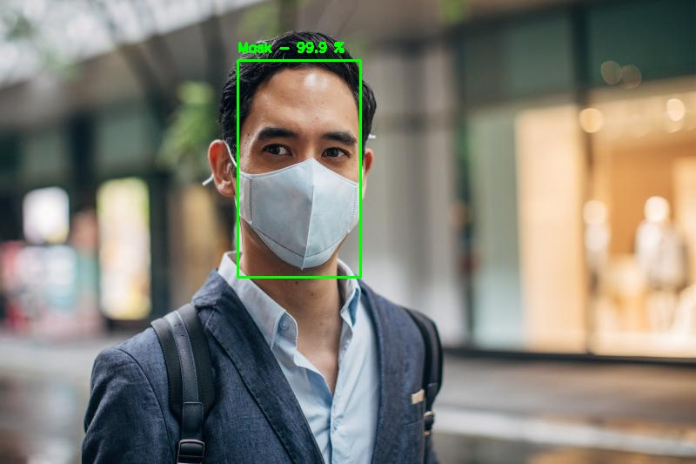
Results (contd…)
Detection on image

Slide 9
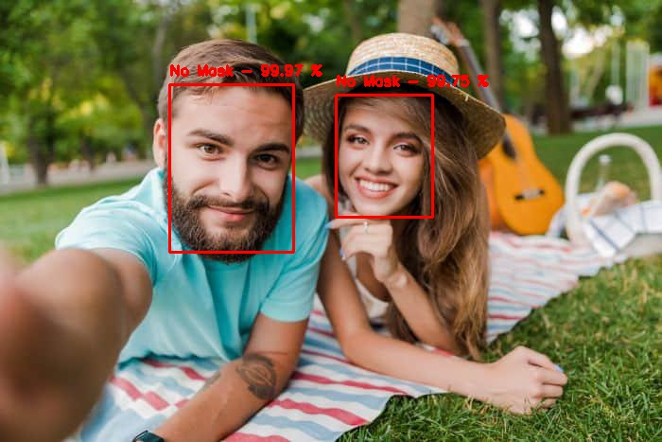
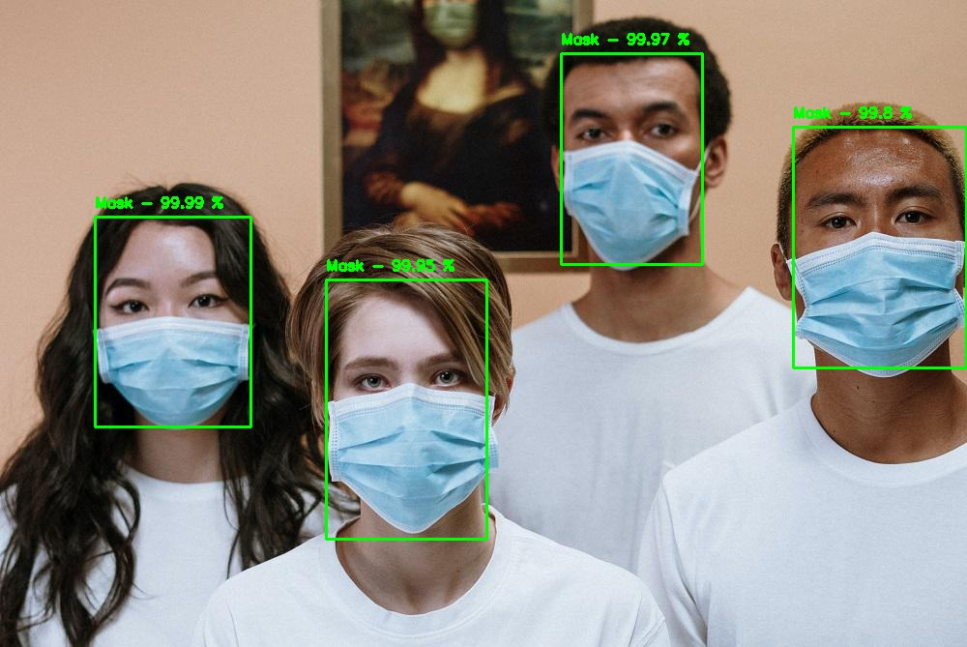
Results (contd…)
Detection on image containing multiple faces

Slide 10
References
H. Li, et al., in Proceedings of the IEEE conference on computer vision and pattern recognition (2015), pp. 5325–5334.
N.C. Ristea, R.T. Ionescu, Are you wearing a mask? improving mask detection from speech using augmentation by cycle-consistent gans, arXiv:2006.10147 (2020).
P. Khandelwal, et al., Using computer vision to enhance safety of workforce in manufacturing in a post covid world, arXiv:2005.05287 (2020).
B. QIN, D. LI, Identifying facemask-wearing condition using image super-resolution with classification network to prevent covid-19 (2020).
Dataset, by Chandrika Deb
Face detection using Caffe ResNet10
Face mask detection using MobileNetV2
Thank You!

